Slide 1
A Methodology and Formalism to Handle Timing Uncertainties in Cyber-Physical Systems
Mohammadreza Mehrabian
Notes:
Hello everyone and welcome to my defense. I would like to first thank the members of my dissertation committee and my friends for attending my Ph.D. defense.
Today, I present my dissertation towards my Ph.D. in Computer Engineering.

Slide 2
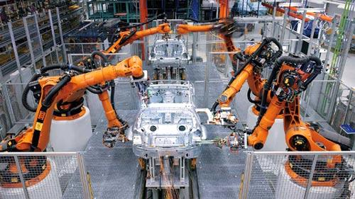
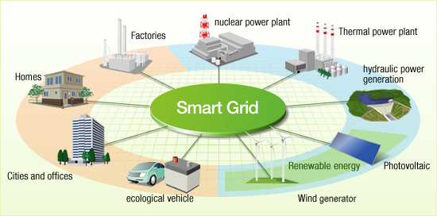
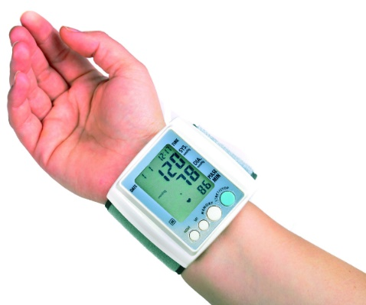
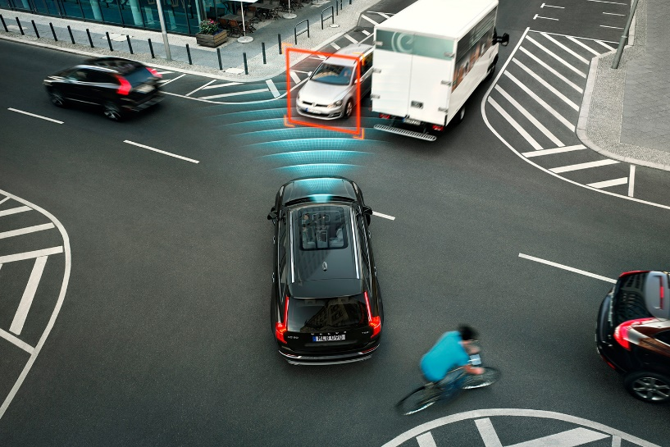

Correct Timing is Important for Cyber-Physical Systems (CPS)
Cyber-Physical Systems (CPS) are integrations of computation, networking, and physical processes.
The cyber part of CPS should process the collected data from physical part and actuate at the right time.
What happens if a deadline is missed?
Performance constraints
Degradation of performance in non-critical application
Safety constraints
A catastrophe in critical applications
Timing Constraints of CPS Should be Met.
Meeting Timing Constraints in CPS is a Challenge.
Architecture
Branch Prediction
Operating Systems
Unbounded Preemption
Starvation for Shared Resources
Programming Languages
Lack of Timed base Instructions
Cache
Notes:
A Cyber-physical System is an orchestration of computer world and physical system. In fact, the sensors make an understanding of the surrounding environment for the processing part to deliver a service at the right time.
If a deadline is missed in a CPS, a catastrophe occurs in safety-critical applications and there is performance degradation in non-critical applications.
Therefore, the timing constraints of CPS should be met.
However,
In order to make time for CPS there are some challenges in computer architecture level like branch prediction and caches,
In Operating system level (like unbounded preemptions),
or lack of time-based instructions in programming languages.

Slide 3
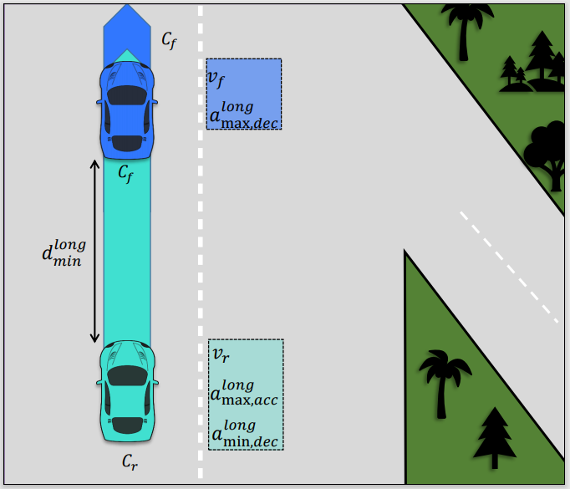
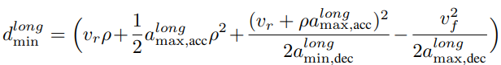
Considering Uncertainty is Important in CPS
Uncertainty: The lack of knowledge about the exact value of some parameters
The value of a signal.
The time of an event or duration between two events.
Sources of Uncertainty
Physical Processes, Sensor, Actuator, Network, Controller, Time.
Uncertainty is Intrinsic in Cyber-Physical Systems
CPS Interact with analog world while the computation and network parts in digital worlds.
Not considering Uncertainties can lead a system to unsafe behavior
Conservative uncertainty estimates can lead to low-performance design.
Example:
Minimum Longitudinal distance in RSS
Notes:
In addition to mentioned challenges to make the right timings for CPS, the other important issue is the role of uncertainties in CPS.
In fact, Uncertainty means the lack of knowledge about the exact value of some measured parameters.
In CPS, the measured values or the time of measurement contain uncertainties. So, there are two types of uncertainties. Value and Time.
The uncertain values come form Physical Processes, Sensor, Actuator, network, Time, and so on. For example, the uncertainty in sensor is about reading wrong values due to noise or having delay in reading.
One example to show the impact of uncertainties on CPS behavior is depicted in the figure.
The problem is maintaining the longitudinal safe distance between two vehicles $C_{r}$ and $C_{f}$. In order to keep the distance, we need the measured velocity of both front and rear vehicles.
If we do not consider uncertainties in the measured parameters, the calculated minimum distance may be less than the required one, so it puts the vehicles in danger.
To solve this problem, one solution is considering the worst-case possible values for uncertain parameters. By this solution, we actually make the system too conservative and lead it to a low-performance design. And it may not be a good solution for all applications.
Therefore, we should handle uncertainties in a wisely manner.

Slide 4
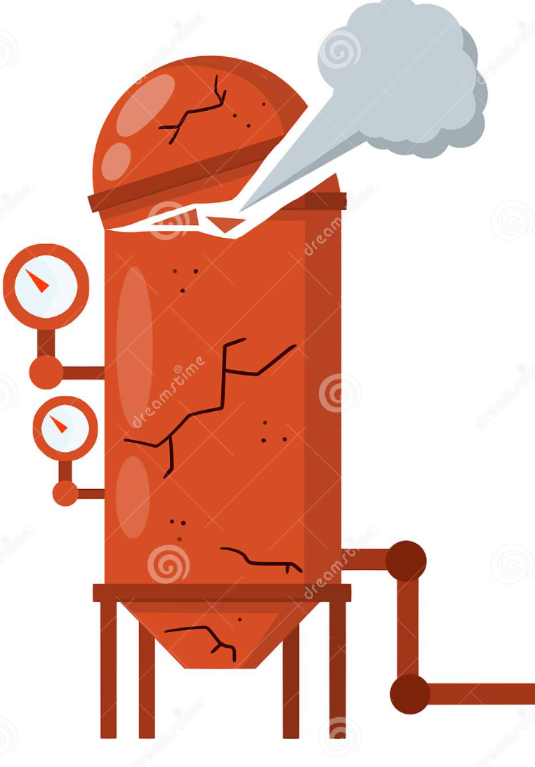
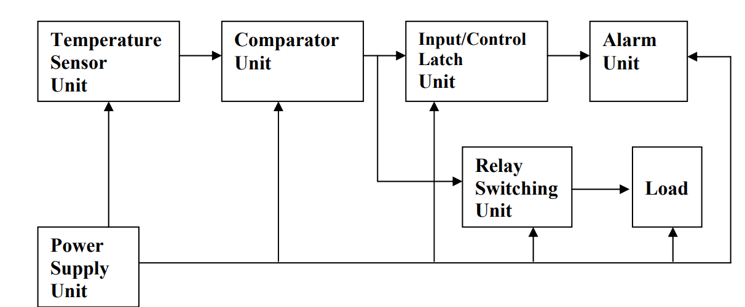
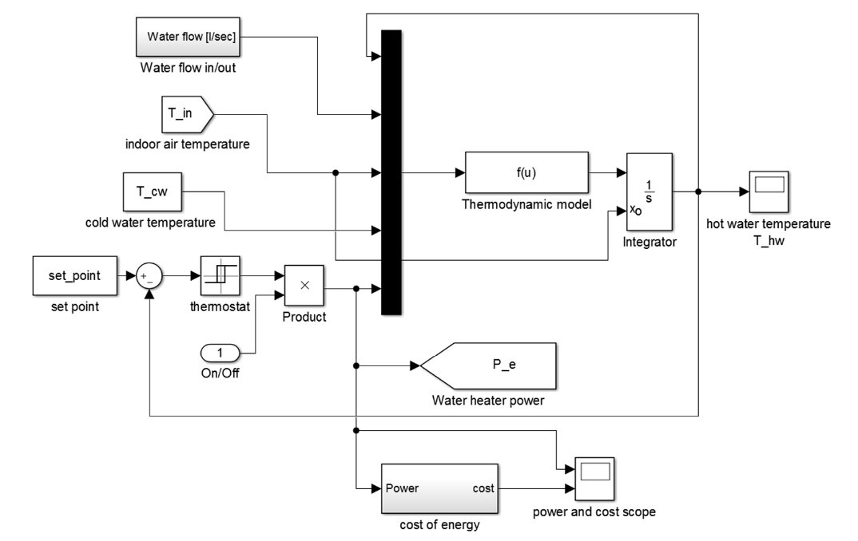
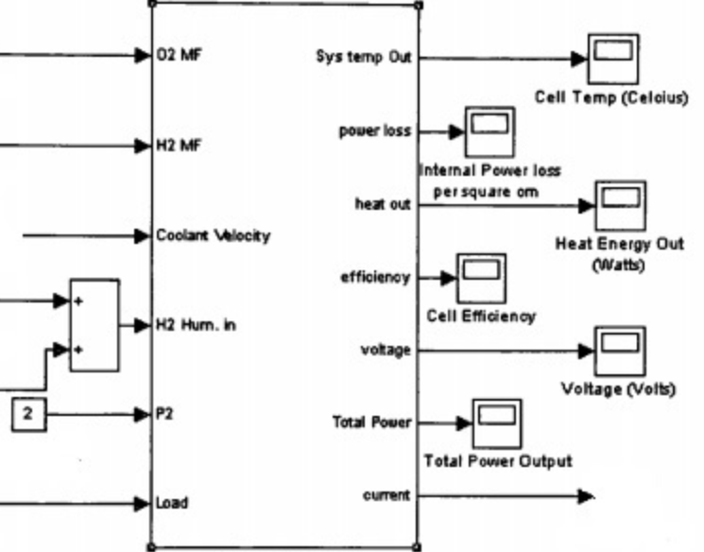
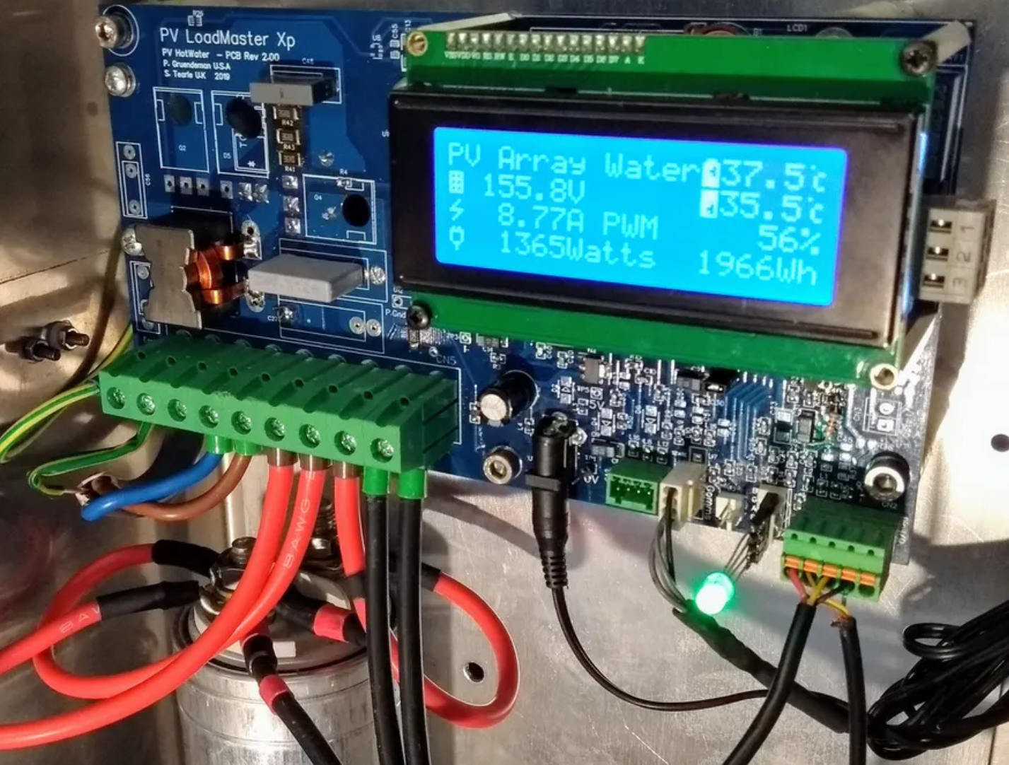
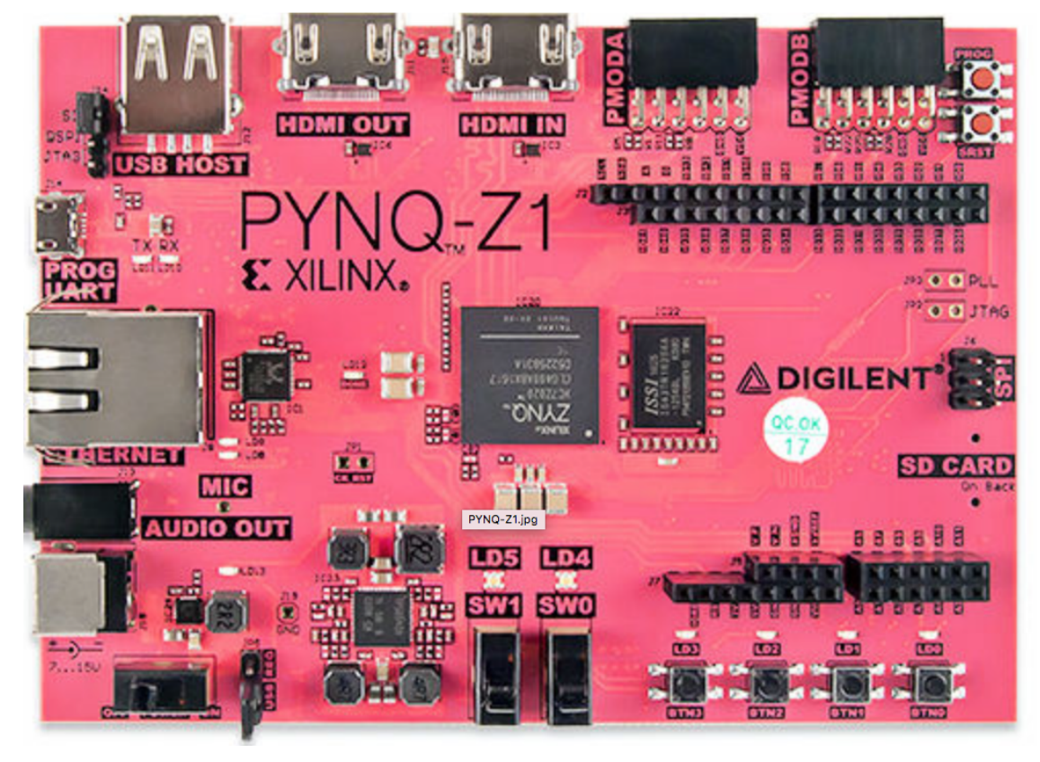
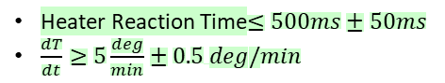
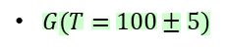
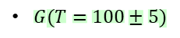
How to Handle Timing Uncertainty in CPS
Conceptual Model
Simulation
Verification
Specification
Heater Reaction Time$≤500ms±50ms$
$\frac{dT}{dt}≥5\frac{deg}{min}±0.5 deg/min$
Validation
Manufacturing
Water Heater
Modeling,
Simulation
& Verification
Tolerance Needs to be considered in the system property.
Properties must be consistent considering uncertainties.
$G(T=100±5)$
Fixed-point calculation
ADC resolution
Validation
& Testing
Testing methods must take the uncertain values and tolerance into account
Testing methods must take uncertainties and tolerance into account.
$G(T=100±5)$
Fixed-point calculation
ADC resolution
Sampling Frequency is high enough
Notes:
In order to handle uncertainty in CPS, we should consider the deviations for uncertain values in three different phases:
In system Specification,
In System Modeling, Simulation, and verification,
In system Validation and Testing.
In the system specification, the high-level specifications should be defined with considering uncertainties.
In modeling, simulation and verification, we need to convert high-level specifications into system properties with expressing tolerance as a part of expressions. This is because an expression should be clear enough to know within which level of accuracy it should be implemented and also tested. We call the level of accuracy as Tolerance. We need tolerance because measurement systems are not perfect, and we cannot do computations with infinite precision.
The other thing about expressing the system properties is doing consistency check among all CPS specifications. This step is required, and it should be done with considering tolerance and existing uncertainties in the system. Otherwise, the consistency check is unrealistic and meaningless.
In the step of validation and testing, we need to take uncertainties and tolerances into account to have right validation. This is important since in this step we monitor the actual device interacting with real environment.
As the last part, we also must validate the monitoring systems to make sure they are good enough to monitor a specific CPS. For example, if Tolerance is defined in the level of microsecond, we cannot monitor it by a monitoring device with precision of milliseconds.

Slide 5
Conceptual Model
Thesis Statement: Timing Uncertainties Must be Handled in CPS Specification, Modeling, and Validation
Simulation
Verification
Heater Reaction Time$≤500ms±50ms$
$\frac{dT}{dt}≥5\frac{deg}{min}±0.5 deg/min$
Specification
Tolerance Needs to be considered in the system properties.
Proposed Timestamp Temporal Logic (TTL) explicitly expresses the Tolerance with which system properties must be met
System properties must be consistent, considering tolerances.
Proposed TTL reasoning system that provides axioms and rules to perform consistency check among timing specifications while considering tolerances.
Validation
Manufacturing
Water Heater
Modeling,
Simulation
& Verification
$G(T=100±5)$
Uncertainties and tolerances should be considered when choosing testing equipment.
Proposed a methodology to test if a monitoring device will allow system properties expressed in TTL (with tolerance) to validate the built CPS (with uncertainties).
Testing methods must take uncertainties and tolerance into account.
Proposed an efficient Monitoring Approach (TMA) that provides one-way guarantee that the built system meets the system properties expressed in TTL (with tolerance), even in the presence of measurement uncertainties.
Fixed-point calculation
ADC resolution
Validation
& Testing
$G(T=100±5)$
Fixed-point calculation
ADC resolution
Sampling Frequency is high enough
Notes:
Therefore, my thesis focuses on Timing Uncertainties in CPS.
In order to consider tolerance in the system specification, I proposed Timestamp Temporal Logic (TTL). In TTL, there is a room to add Tolerance and in order to evaluate the predicates, TTL proposes a set of mathematical equations.
As the second part, the reasoning system that is a set of axiom, rules, and the way to proof TTL statements, is proposed to check the consistency among all related TTL statements. This capability is done with taking uncertainties and tolerances into account so that the results will be very close to the real implementations.
In order to choose the right equipment to monitor a certain CPS, some metrics are proposed in the third section. It shows whether a monitoring system is good enough for testing a specific CPS or not.
Finally, I will present TMA, which is an efficient monitoring method taking the events on the signals instead of their real values for monitoring. Since TMA utilizes TTL as its temporal logic language, it intrinsically considers tolerance and Uncertainties in synthesizing on FPGA.

Slide 6
Conceptual Model
Simulation
Thesis Statement: Timing Uncertainties Must be Handled in CPS Specification, Modeling, and Validation
Verification
Heater Reaction Time$≤500ms±50ms$
$\frac{dT}{dt}≥5\frac{deg}{min}±0.5 deg/min$
Specification
Tolerance Needs to be considered in the system properties.
Proposed Timestamp Temporal Logic (TTL) explicitly expresses the Tolerance with which system properties must be met
System properties must be consistent, considering tolerances.
Proposed TTL reasoning system that provides axioms and rules to perform consistency check among timing specifications while considering tolerances.
Validation
Manufacturing
Water Heater
Modeling,
Simulation
& Verification
$G(T=100±5)$
Uncertainties and tolerances should be considered when choosing testing equipment.
Proposed a methodology to test if a monitoring device will allow system properties expressed in TTL (with tolerance) to validate the built CPS (with uncertainties).
Testing methods must take uncertainties and tolerance into account.
Proposed an efficient Monitoring Approach (TMA) that provides one-way guarantee that the built system meets the system properties expressed in TTL (with tolerance), even in the presence of measurement uncertainties.
Fixed-point calculation
ADC resolution
Validation
& Testing
$G(T=100±5)$
Fixed-point calculation
ADC resolution
Sampling Frequency is high enough
Mehrabian, Mohammadreza, Mohammad Khayatian, Aviral Shrivastava, John C. Eidson, Patricia Derler, Hugo A. Andrade, Ya-Shian Li-Baboud, Edward Griffor, Marc Weiss, and Kevin Stanton. "Timestamp temporal logic (TTL) for testing the timing of cyber-physical systems." ACM Transactions on Embedded Computing Systems (TECS) 16, no. 5s (2017): 1-20.
Notes:
Now, I am going to present TTL.
The first part of my dissertation is about TTL that gives designers enough room to express tolerance in temporal statements. By knowing the tolerance, developers (containing the CPS and Verification developers) are aware of the required precision to implement or verify a specific temporal statement.

Slide 7
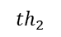
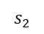
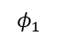
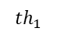
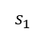
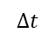
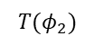
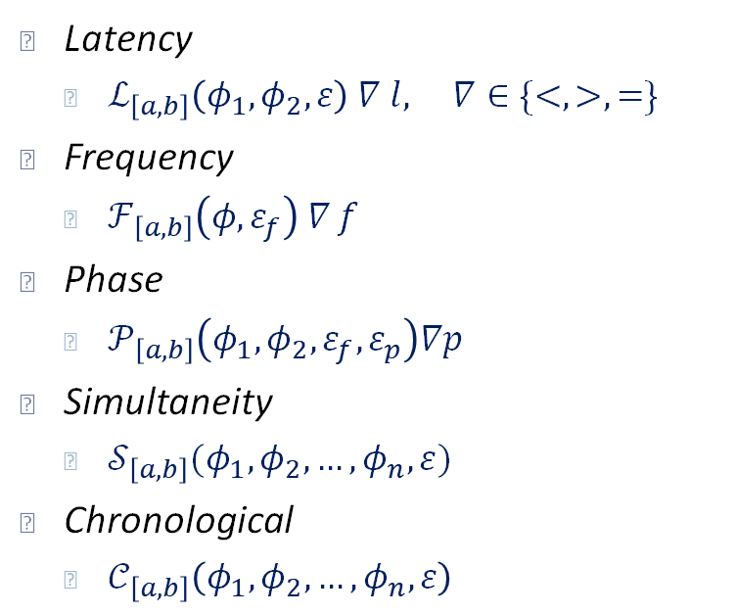
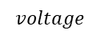
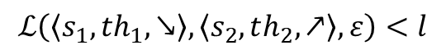
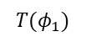
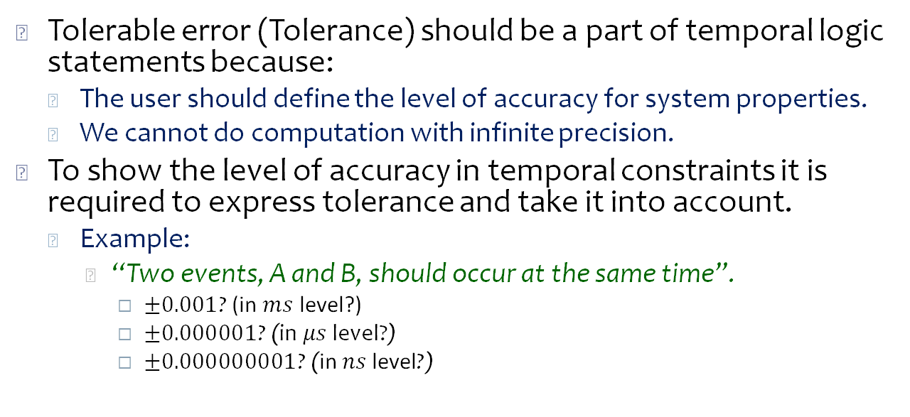
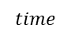
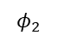
Timestamp Temporal Logic (TTL) Can Express Tolerance
Latency
$ℒ_{\left[a,b\right]}\left(φ_{1},φ_{2},ε\right) ∇ l, ∇∈\{<,>,=\}$
Frequency
$ℱ_{\left[a,b\right]}\left(φ,ε_{f}\right) ∇ f$
Phase
$𝒫_{\left[a,b\right]}\left(φ_{1},φ_{2},ε_{f},ε_{p}\right)∇p$
Simultaneity
$𝒮_{\left[a,b\right]}(φ_{1},φ_{2},…,φ_{n},ε)$
Chronological
$𝒞_{\left[a,b\right]}\left(φ_{1},φ_{2},…,φ_{n},ε\right)$
Tolerable error (Tolerance) should be a part of temporal logic statements because:
The user should define the level of accuracy for system properties.
We cannot do computation with infinite precision.
To show the level of accuracy in temporal constraints it is required to express tolerance and take it into account.
Example:
“Two events, A and B, should occur at the same time”.
$±0.001$? (in $ms$ level?)
$±0.000001$? (in $μs$ level?)
$±0.000000001$? (in $ns$ level?)
$$voltage$$
$$th_{1}$$
$$φ_{1}$$
$$s_{1}$$
$$T(φ_{1})$$
$$s_{2}$$
$$ℒ\left(〈s_{1},th_{1},↘〉,〈s_{2},th_{2},↗〉,ε\right)<l$$
$$th_{2}$$
$$φ_{2}$$
$$T{(φ}_{2})$$
$$time$$
$$Δt$$
Notes:
In specifying the system properties, Tolerance should be a part of temporal logic since we always have uncertainties in the system and user should define the level of accuracy. Otherwise, it is not possible to make the timings for the system and also verify them.
Moreover, since some values are real numbers, it is not possible to do the computations with infinite precision.
For example, if a constraint is this: “two events, A and B, should occur at the same time”, because of the aforementioned reasons it is not possible to have both events exactly at the same time in the real world.
Therefore, we need to know whether A and B should occur at the same time in the level of millisecond precision, or microsecond precision or nanosecond. Intuitively, the level comes form the system specifications. For example, in a video game it can be in a level of hundred milliseconds, but in an airplane, it should be at level of 10 microseconds.
In order to express timing requirements of CPS, TTL has 5 temporal operators where epsilon is added.
Latency expresses the time delay between events $φ_{1}$ and $φ_{2}$, Frequency is to express the frequency of a repetitive event $φ$, phase defines the phase between two repetitive events $φ_{1}$ and $φ_{2}$ when their frequencies are equal, Simultaneity expresses events that occur at the same time within tolerance of epsilon, and Chronological shows the orders of events $φ_{1}$to $φ_{n}$.
As the figure shows in the latency constraint, we calculate the time difference between two events $φ_{1}$ and $φ_{2}$ when their analog signals cross specific thresholds.
___________________________________________________________________
Tolerance important to cover uncertainties
How tolerance is used to handle uncertainties (Example)

Slide 8
Conceptual Model
Simulation
Thesis Statement: Timing Uncertainties Must be Handled in CPS Specification, Modeling, and Validation
Verification
Heater Reaction Time$≤500ms±50ms$
$\frac{dT}{dt}≥5\frac{deg}{min}±0.5 deg/min$
Specification
Tolerance Needs to be considered in the system properties.
Proposed Timestamp Temporal Logic (TTL) explicitly expresses the Tolerance with which system properties must be met
System properties must be consistent, considering tolerances.
Proposed TTL reasoning system that provides axioms and rules to perform consistency check among timing specifications while considering tolerances.
Validation
Manufacturing
Water Heater
Modeling,
Simulation
& Verification
$G(T=100±5)$
Uncertainties and tolerances should be considered when choosing testing equipment.
Proposed a methodology to test if a monitoring device will allow system properties expressed in TTL (with tolerance) to validate the built CPS (with uncertainties).
Testing methods must take uncertainties and tolerance into account.
Proposed an efficient Monitoring Approach (TMA) that provides one-way guarantee that the built system meets the system properties expressed in TTL (with tolerance), even in the presence of measurement uncertainties.
Fixed-point calculation
ADC resolution
Validation
& Testing
$G(T=100±5)$
Fixed-point calculation
ADC resolution
Sampling Frequency is high enough
Mehrabian, Mohammadreza, Mohammad Khayatian, Aviral Shrivastava, Edward Griffor, Ya-Shian Li-Baboud, Patricia Derler, et al. "A Formalism and Methodology for Run-time Verificationof Cyber-Physical Systems using Timestamp TemporalLogic.“ (submitted to TOCS)
Notes:
The second part of my dissertation is about natural deduction on TTL where there are axiom and rules to work on a set of hypotheses and deduce new set of rules. Using the rules, we can do the consistency check on timing specifications of CPS.

Slide 9
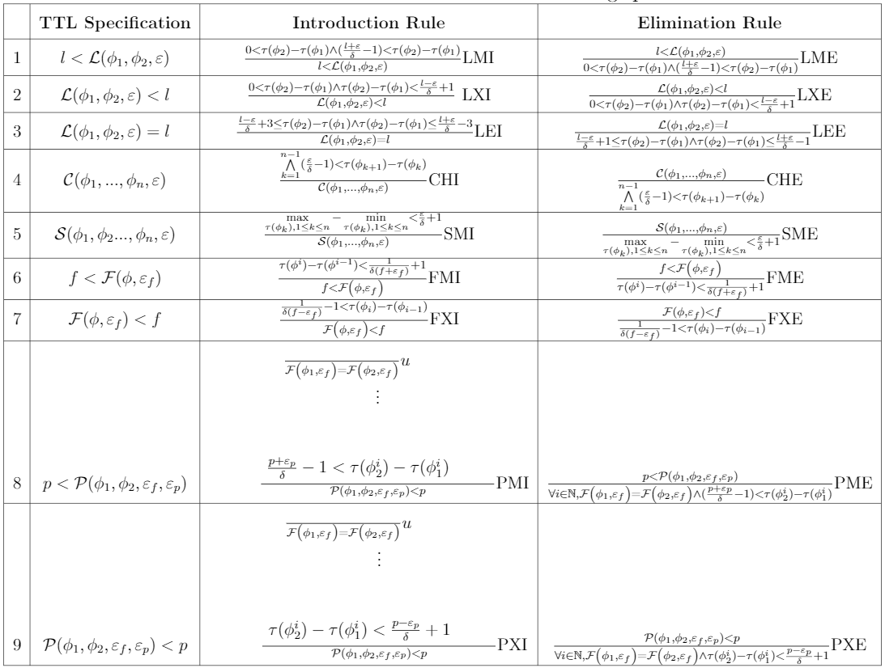
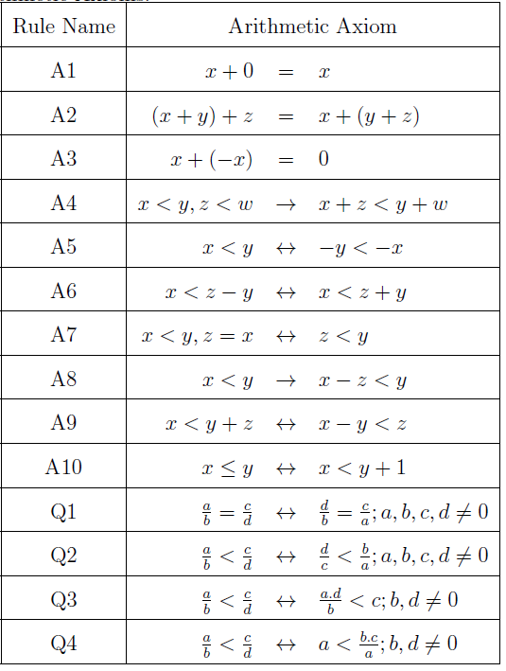
The Axiom and Rules in TTL Reasoning System
Notes:
In this slide, we have the axiom and rules used in the TTL natural deduction. In the table on the left, the columns show the Introduction and Elimination rules for each TTL operator. In fact, The elimination rules define how to convert a TTL statement to mathematical equations considering timestamps, tolerance, and measurement uncertainty (that is $δ$).
The introduction rules explain if we have some relation among the timestamps, measurement uncertainty ($δ)$, and tolerance ($ε)$, how we can convert those relations into TTL timing expressions.
For example, in the first row, the introduction rule for minimum latency elaborates that if the subtraction between two timestamps of two events are bigger than a certain value, we can conclude a latency constraint between those two events.
The elimination rule for minimum latency says if we have a latency constraint between two events that is evaluated to true, the difference between their timestamps is greater than a certain value.
The right table, demonstrates a set of arithmetic rules that are used to combine statements.
______________________________________________________________________________
Arithmetic rules are used in Introduction rules to have TTL statements.

Slide 10
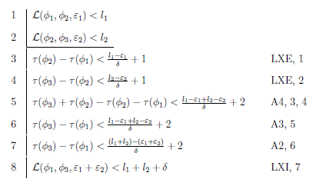
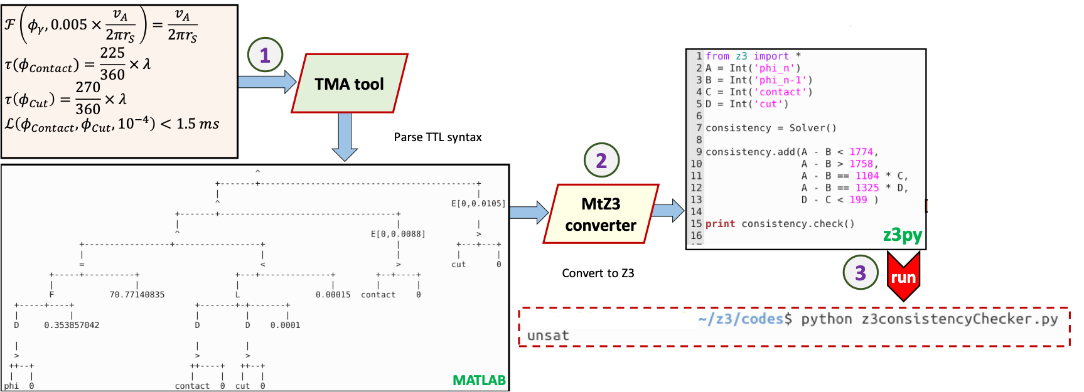
How to Use Natural Deduction in TTL for Consistency Check
The rule name and the line on which a rule is applied.
Elimination rules
A natural deduction proof begins with assumptions and/or hypotheses, and then applies the rules.
Using the proposed monitoring method and a SMT solver we can check the consistency of statements.
Line number
Introduction rule
Applied rules
Notes:
The way that the TTL reasoning system deduces new statements is using natural deduction on mathematical logic.
The style of reasoning system for TTL in an example is demonstrated in the right figure. On the top, we have the hypotheses that are the assumptions, then there is a horizontal line to separate the assumptions and the deduction steps.
In each line, we use a TTL rule or axiom and the statements in upper lines.
The figure on the left shows the proposed tool to do the consistency check. It has 3 steps:
In step one we do Parsing. Timestamp-based Monitoring Approach (TMA tool that is explained later) generates the parse tree for TTL statements, initiates the variables, and provides the arithmetic expressions.
In step 2, the result from TMA that is in arithmetic equation format is converted to python code and is made ready to check their consistency using Z3py library.
In the last step, the provided Python code is executed and z3py library generates a result showing whether the hypotheses are satisfied or not.

Slide 11
Conceptual Model
Simulation
Thesis Statement: Timing Uncertainties Must be Handled in CPS Specification, Modeling, and Validation
Verification
Heater Reaction Time$≤500ms±50ms$
$\frac{dT}{dt}≥5\frac{deg}{min}±0.5 deg/min$
Specification
Tolerance Needs to be considered in the system properties.
Proposed Timestamp Temporal Logic (TTL) explicitly expresses the Tolerance with which system properties must be met
System properties must be consistent, considering tolerances.
Proposed TTL reasoning system that provides axioms and rules to perform consistency check among timing specifications while considering tolerances.
Validation
Manufacturing
Water Heater
Modeling,
Simulation
& Verification
$G(T=100±5)$
Uncertainties and tolerances should be considered when choosing testing equipment.
Proposed a methodology to test if a monitoring device will allow system properties expressed in TTL (with tolerance) to validate the built CPS (with uncertainties).
Testing methods must take uncertainties and tolerance into account.
Proposed an efficient Monitoring Approach (TMA) that provides one-way guarantee that the built system meets the system properties expressed in TTL (with tolerance), even in the presence of measurement uncertainties.
Fixed-point calculation
ADC resolution
Validation
& Testing
$G(T=100±5)$
Fixed-point calculation
ADC resolution
Sampling Frequency is high enough
Shrivastava, Aviral, Mohammadreza Mehrabian, Mohammad Khayatian, Patricia Derler, Hugo Andrade, Kevin Stanton, Ya-Shian Li-Baboud, Edward Griffor, Marc Weiss, and John Eidson. "A testbed to verify the timing behavior of cyber-physical systems." In Proceedings of the 54th Annual Design Automation Conference 2017, pp. 1-6. 2017.
Notes:
In this part of presentation, I show the important parameters that effect the precision of CPS monitoring system and a way to make sure a monitoring system is good enough to test a specific CPS.

Slide 12
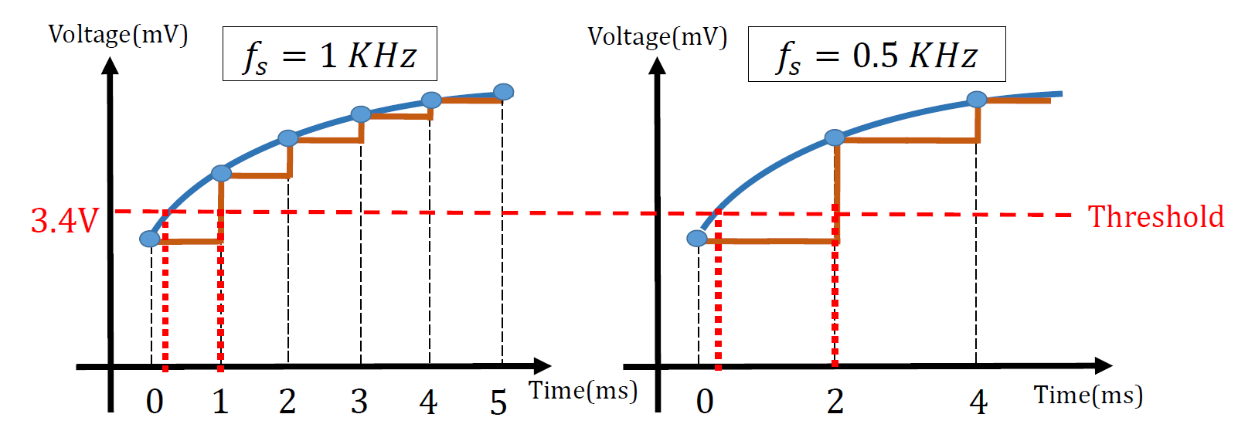
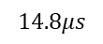
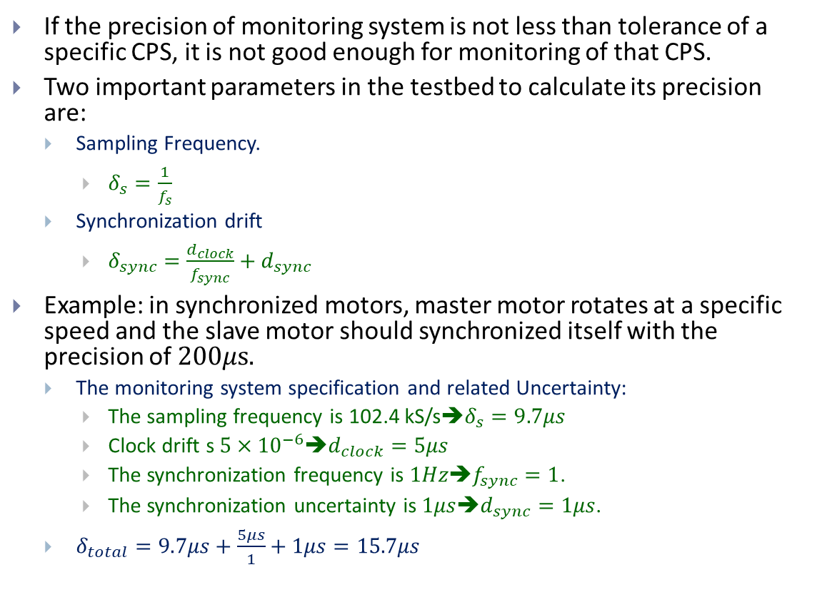
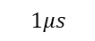
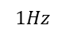
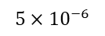
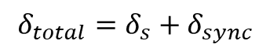
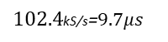
Testbed Should be Precise Enough for Monitoring
If the precision of monitoring system is not less than tolerance of a specific CPS, it is not good enough for monitoring of that CPS.
Two important parameters in the testbed to calculate its precision are:
Sampling Frequency.
$δ_{s}=\frac{1}{f_{s}}$
Synchronization drift
$δ_{sync}=\frac{d_{clock}}{f_{sync}}+d_{sync}$
Example: in synchronized motors, master motor rotates at a specific speed and the slave motor should synchronized itself with the precision of $200μs.$
The monitoring system specification and related Uncertainty:
The sampling frequency is 102.4 kS/s➔$δ_{s}=9.7μs$
Clock drift s $5×{10}^{−6}$➔$d_{clock}=5μs$
The synchronization frequency is $1Hz$➔$f_{sync}=1$.
The synchronization uncertainty is $1μs$➔$d_{sync}=1μs$.
$δ_{total}=9.7μs+\frac{5μs}{1}+1μs=15.7μs$
$$δ_{total}=δ_{s}+δ_{sync}$$
Sampling Frequency impact
$$5×{10}^{−6}$$
clock
clock
Clock Drift
Clock drift
Clock drift
Total Uncertainty
$$1Hz$$
$$14.8μs$$
Sync Frequency
time
time
$$1μs$$
Synchronization Frequency impact
Sync Error
Sampling Uncertainty
$102.4$kS/s=$9.7μs$
ADC resolution impact
Input impedance impact
Notes:
As mentioned before, users can define tolerance that is the maximum allowable uncertainties in the system. In fact, testbed uncertainty should be definitely less than tolerance.
Two important parameters to calculate timing uncertainties in CPS testbed are Sampling Frequency and Clock drift.
As the figures on the top are showing, sampling frequency causes uncertainty on the detection time of events.
Moreover, for geographically distributed CPS, there is another important parameter that is Clock drift that is the uncertainty in clock value. Since we need to synchronize the clocks in different parts, the uncertainty regarding both local clock and reference clock should be clear and taken into account.
The figures on the bottom are demonstrating that synchronization frequency impacts the clock uncertainty. The figure on the right has higher synchronization frequency and hence, the clock uncertainty is less.
In order to calculate the overall uncertainty, we should accumulate the sampling uncertainty and clock uncertainty. The sampling uncertainty is the reverse of the sampling frequency and that is the maximum possible uncertainty in discretization process.
In the clock part, we need to add clock drift with considering synchronization frequency and also the synchronization uncertainty. So, we can calculate $δ_{total}.$
For example, in one of our experiments, we have implemented an application containing two synchronized motors. One motor rotates in a certain velocity and the other one synchronizes itself with the first motor.
In that application, we needed to have motors at the same phase with $200μs$accuracy (the tolerance was $200 μs$).
The frequency of monitoring system was $102.4$ kS/s hence, the sampling uncertainty is $9.7μs$
The clock drift of the monitoring system (NI-cRIO) was $5μs$ when the synchronization is performed every second with the uncertainty of $1μs$. Therefore, we have $5μs$ over 1 plus $1μs$ as the clock uncertainty.
If we add $9.7μs$ as the sampling frequency, we totally have $15.7μs$ as the uncertainty in monitoring system that is low enough to monitor a system with tolerance of $200μs$.

Slide 13
Conceptual Model
Simulation
Thesis Statement: Timing Uncertainties Must be Handled in CPS Specification, Modeling, and Validation
Verification
Heater Reaction Time$≤500ms±50ms$
$\frac{dT}{dt}≥5\frac{deg}{min}±0.5 deg/min$
Specification
Tolerance Needs to be considered in the system properties.
Proposed Timestamp Temporal Logic (TTL) explicitly expresses the Tolerance with which system properties must be met
System properties must be consistent, considering tolerances.
Proposed TTL reasoning system that provides axioms and rules to perform consistency check among timing specifications while considering tolerances.
Validation
Manufacturing
Water Heater
Modeling,
Simulation
& Verification
$G(T=100±5)$
Uncertainties and tolerances should be considered when choosing testing equipment.
Proposed a methodology to test if a monitoring device will allow system properties expressed in TTL (with tolerance) to validate the built CPS (with uncertainties).
Testing methods must take uncertainties and tolerance into account.
Proposed an efficient Monitoring Approach (TMA) that provides one-way guarantee that the built system meets the system properties expressed in TTL (with tolerance), even in the presence of measurement uncertainties.
Fixed-point calculation
ADC resolution
Validation
& Testing
$G(T=100±5)$
Fixed-point calculation
ADC resolution
Sampling Frequency is high enough
Mehrabian, Mohammadreza, Mohammad Khayatian, Ahmed Mousa, Aviral Shrivastava, Ya-Shian Li-Baboud, Patricia Derler, Edward Griffor et al. "An efficient timestamp-based monitoring approach to test timing constraints of cyber-physical systems." In Proceedings of the 55th Annual Design Automation Conference, pp. 1-6. 2018.
Notes:
As the last part of this dissertation, I will present the way to synthesis the timing specifications for online monitoring. After having the temporal specifications of a CPS in TTL and checking the consistency, it is possible to implement those expressions for monitoring system with considering uncertainties and tolerances.

Slide 14

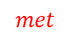
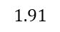
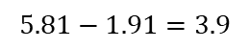
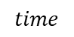
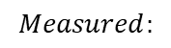
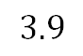
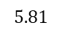
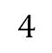
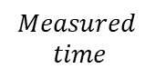









Shortcomings of Existing Monitoring Methods
$$4$$
Monitoring system cannot correctly evaluate temporal statements
Because measurement systems always have errors
If measurement devices are perfect, then there is no problem.
Example
$□_{\left[1,5\right]}ψ:$ In the next 1 to 5 seconds, $ψ$ should be constantly $⊤.$
The width of appositive pulse should be at least $5s−1s=4s$.
The sampling time is $δ=0.2s$
Problem: Given the constraint $□_{\left[2,6\right]}ψ$, even though the measurement system says the constraint is met, but actually is not met
Existing Monitoring Methods cannot evaluate statements in existing temporal logic formalisms correctly
Even with a less value for $δ$ there exits a level of inaccuracy.
Even a very slight error value can cause a catastrophe.
$$3.9$$
$$ψ$$
$$1.91$$
$$2$$
$$5.81$$
$$6$$
$$time$$
$$Actual$$
$$time$$
$$Measured$$
$$time$$
Ac$tual:$
$$5.81−1.91=3.9$$
$$not met$$
$$Measured:$$
$$6−2=4≤4$$
$$met$$
$$d_{min}$$
collision
Automatic braking
Notes:
In this slide I show that the existing monitoring methods are not able to correctly monitor statements in current temporal logic languages.
The reason is the existing measurement uncertainties in the monitoring devices.
If monitoring equipment are perfect in measuring, there is no problem. However, it is not possible to have perfect measurement devices.
The example shows the problem.
$□_{\left[1,5\right]}ψ$ defines that in the next 1 to 5 seconds, the value of $ψ$ should be always true and it means $ψ$ should be true for at least 4 seconds. Assume, the sampling time for discretizing is 0.2 second and sampling starts from zero.
The figure on top shows that signal $ψ$ becomes true at 1.91 sec and comes back to false at 5.81 s. Obviously, it does not satisfy the constraint saying the width of positive pulse should be at least 4 (it equals to 5.81 – 1.91 = 3.9).
However, the time of rising and falling edges detected by the discrete system is 2 and 6 respectively (so we have 6-2 = 4 that is less and equal to 4 and shows the specification is met).
In fact, it demonstrates that the constraint is met while in reality it has not been met. It is a False Negative and is a very important issue.
_________________________________________________________________________________
Consider the example here in the image below. There are two vehicles driving on the same road facing the same direction. The distance between them should be at least $d_{min}$ to keep both safe. Assume we monitor the brake reaction time for the situation in which the distance is less than $d_{min}$ and it shows there is no violation while it is actually violated. Such false positive detection, is misleading and very important issue in safety-critical applications.
Again, as a fact, the STL statements cannot be evaluated correctly since no measurement device is perfect and even with a very slight error there is a chance to evaluate them incorrectly.

Slide 15














TMA Provides One-way Guarantee in Verification
One of the benefits of using TTL is the guarantee to have accurate verification, and this is a one-way guarantee.
$δ$ is maximum measurement error and $ε$ is Tolerance.
We know $δ<ε$.
In calculating latency between $φ_{1}$ and $φ_{2}$ since the time of their occurrence is converted to integer, there is an interval for $φ_{1}$ and $φ_{2}$ that converted to the upper bound.
It is a gray area.
By decreasing $ε$ (not less than $δ$) the gray distance is smaller and hence it is not clear that the constraint is met or not.
By increasing the value of $ε$ we take the entire interval as violated but we increase the chance of false positive.
$$not met$$
$$met$$
Example:
$$ℒ\left(φ_{1},φ_{2},0.4\right)>4, δ=0.2$$
$ε$, it is taken as not met
$ℒ_{\left[a,b\right]} \left(φ_{1},φ_{2},ε\right)> l$:
iff$∃t^{′}∈[t+a,t+b]$ s.t. $\left(σ,t^{′}\right)⊨φ_{1}$ and
$∃t^{′′}>t′$ s.t. $\left(σ,t^{′′}\right)⊨φ_{2}$ and$\left(t^{′′}−t^{′}\right)>\frac{l+ε}{δ}−1,ε>δ$
$$φ_{1}$$
$$φ_{2}$$
$$time$$
$$1.8$$
$$2$$
$$5.8$$
$$6$$
Notes:
This slide shows the way TMA can solve the problem by TTL.
One of the benefits of using TTL is the guarantee to have accurate verification, and this is a one-way guarantee.
Here I show how TMA provides one-way guarantee for accurate monitoring of CPS to cover false negative rate.
Assume the maximum measurement error in the system is $δ,$ and $ε$ is the tolerance and $ε>δ.$
Suppose we want to monitor the latency between the events $φ_{1}$ and $φ_{2}$ and it should be more than 4 seconds.
As the figure demonstrates, if $φ_{1}$ occurs between 1.8 and 2, the discretization system gives it as 2. If $φ_{2}$ occurs between 5.8 and 6, it is taken as 6. Therefore, depending on occurrence time of $φ_{1}$, if $φ_{2}$ occurs between 5.8 and 6, a portion of the interval 5.8 to 6 satisfies the latency statement and the rest may not.
Indeed, the aim is removing false negative rate. false negative means verification system says constraint is met, BUT it has been actually not met.
In order to make sure we are not generating False Negatives we take the entire interval (I mean 5.8 to 6) as violated. And, it is done by choosing $ε$ when it’s greater than the maximum error that is $δ.$
By choosing $ε$ a little bit greater than $δ$, the judgment is violated for even the part in which the constraint was met. So, it produces false positive (false positive means the verification system says the timing constraint is not met, BUT it has been actually met). It is a conservative approach, and this is because we don’t want to say it is met when the constraint has not been met.
However, having false positive judgements is evitable. It is a tradeoff, and we cannot reduce false positive and false negative at the same time. Hence, TMA provides one-way guarantee to have accurate monitoring and make the False Negative rate to zero.

Slide 16




















How the Existing Approaches and TMA Monitor Level-based CPS Timing Constraints
$□_{\left[3,8\right]}\left(ψ\right)$
Between 3 to 8 time unit after now, signal $ψ$ should be always true.
Traditional methods
Look at all time-step in the interval to evaluate for every time-step.
Optimized methods look into a portion of the interval.
However, required memory and computation iterations still depend on the interval.
TMA
For event-base timing constraints, the timestamps of events are taken for evaluation.
For level-based timing constraints it looks at rising and falling edges as events.
Just examine the timestamps of the most recently events.
Globally in TMA
The width of a positive pulse should be at least a-b
For such pulse, the first time at which the evaluation is true is the rising edge minus $a$.
On the other side, the last time at which the evaluation is true is the falling-edge minus $b$.
$$⊤$$
$$ψ$$
$$⊥$$
$$⊤$$
$$□_{\left[3,8\right]}ψ$$
$$⊥$$
$$t_{1}$$
$$t_{2}$$
$$t_{2}+8$$
time
$$t_{2}+3$$
$$t_{1}+3$$
$$t_{1}+8$$
$$⊤$$
$$t_{r}^{ψ}−3$$
$$⊥$$
$$ψ$$
$$⊤$$
$$t_{f}^{ψ}−8$$
$$⊥$$
$$□_{\left[3,8\right]}ψ$$
$$t_{r}^{ψ}$$
$$t_{f}^{ψ}$$
time
Notes:
In this slide, I talk about how the existing methods works on monitoring of temporal logic statements and how the proposed method, TMA, monitors the timing specifications of CPS.
In existing monitoring approaches, in order to evaluate an operator at time t, all timesteps in the related interval should be evaluated.
For example, in the top right figure, in ${}_{\left[3,8\right]}(ψ)$ at time t, we should look at all moments from t+3 to t+8. If $ψ$ is true for all moments, the evaluation for time t is true. Otherwise, it is false at t. In this example, since from $t_{1}+3$ to $t_{1}+8$, $ψ$ is false for a short time, the evaluation is false at $t_{1}.$ However, since $ψ$ is true at all moments from $t_{2}+3$ to $t_{2}+8,$ the evaluation is true for $t_{2}.$
As a different implementation, TMA just works on the last rising and falling edges of a Boolean signal. Since it does not depend on the interval, the processing and required memory is constant for any interval. It just does the calculation for the timestamps of rising and falling edges.
-----------------------------------------------------
For the statements that receive Boolean signals, they are called level-based statements like globally, the method looks at rising and falling edges as events and uses their timestamps.
For example, as it is shown in the bottom figure, to evaluate the satisfaction of globally since it is $□_{\left[3,8\right]}ψ$ the width of positive pulse should be more than 8-3which equals to 5 to be true. For such pulse, the first time at which the evaluation is true is the rising edge minus “a”.
On the other side, the last time at which the evaluation is true is the falling-edge minus b. TMA just does those two calculations for evaluating globally. It is crystal clear that its calculation works for any values for a and b and does not need to store the signal values for each moment.

Slide 17














Existing Monitoring Approaches are Compute and Resource Intensive
$T:$ test duration
$f_{s}:$ sampling frequency
Memory:
It needs the entire interval which is in future
$\left(8−3\right)×f_{s}$
Per constraint
Number of comparisons:
$\left(\left(8−3\right)×f_{s} \right)×T×f_{s}$
$$⊤$$
$$ψ$$
$$⊥$$
$$⊤$$
$$□_{\left[3,8\right]}ψ$$
$$⊥$$
$$t_{1}$$
$$t_{2}$$
$$t_{2}+3$$
$$t_{2}+8$$
time
Memory:
It needs the most recent event timestamps
$2$ timestamps
Per falling and rising edge
Number of comparisons:
$2$ timestamps
Per the most recent event timestamps
$$⊤$$
$$t_{r}^{ψ}−3$$
$$⊥$$
$$t_{f}^{ψ}−8$$
$$ψ$$
$$⊤$$
$$⊥$$
$$□_{\left[3,8\right]}ψ$$
$$t_{r}^{ψ}$$
$$t_{f}^{ψ}$$
time
Notes:
In this slide, I show that the traditional methods need a lot of memory and computation power while TMA needs less memory and computation power that is constant for any interval.
In conventional method, since the evaluation is done for each TIMESTEP and for each TIMESTEP we should look at all moments in the interval, we have (8-3) times fs which is sampling frequency to evaluate the constraint just for one timestep.
If we assume the monitoring duration is T, we have T times fs moments for entire monitoring. Therefore, the total number of evaluations is (8-3) times fs times T and times again fs.
The number of comparisons and memory size is just for one constraint. For more constraints, it should multiply to the number of statements.
In contrast, TMA just needs two timestamps of current rising and falling edges and needs to store just last two calculated timestamps.
________________________________________________________________________________________
In TMA, the new rising edge is equal to the rising edge of the $ψ$ minus a, and the new falling edge is equal to rising edge of $ψ$ minus b. Therefore, it does not need memory cells to store the signal values.
------A and b should be replaced by 3 and 8

Slide 18
























How TMA Monitors Event-based CPS Timing Constraints
Simultaneity is true if all $n$ events occur within $ε$.
$𝒮_{\left[a,b\right]}\left(φ_{1},φ_{2},…,φ_{n},ε\right)$
The subtraction of the earliest and the latest events must be less than $ε.$
It can be implemented by a timed automaton.
The other monitoring algorithms are like Simultaneity
$$voltage$$
There is
no event
$${θ_{max}:θ}_{3}$$
$$ε$$
start
$$c=0$$
$${θ_{min}:θ}_{1}$$
1
An event on
$φ_{1}$to${ φ}_{n}$
$$\dot{c}=1$$
The constraint
is not met
$θ_{min}^{φ_{i}}+ε>$c
&&
count(events)$<n$
$$θ_{1}$$
$$θ_{2}$$
$$θ_{3}$$
$$θ_{min}−a$$
3
2
$$θ_{max}−b$$
$$⊤$$
$$t_{r}^{𝒮}=min\left(θ^{φ_{i}}\right)−a$$
count(events)$<n$
$$⊥$$
$$𝒮_{\left[a,b\right]}(φ_{1},φ_{2},φ_{3},ε)$$
4
$$t_{f}^{𝒮}=max\left(θ^{φ_{i}}\right)−b$$
$θ_{min}^{φ_{i}}+ε≤$c
&&
count(events)$==n$
$$t_{r}^{𝒮}$$
$$t_{f}^{𝒮}$$
$$time$$
The constraint
is met
Notes:
This slide is about monitoring event-based timing requirements such as latency, simultaneity and so on.
In event-based timing specifications, we are interested in events rather than the value of signals. Here, we have simultaneity which is a TTL operator.
Simultaneity of several events is true if all events in its statements occur within $ε$ duration. As the figure on the left shows, after knowing that all events from $φ_{1}$ to $φ_{n}$ has occurred, if the maximum timestamp minus minimum timestamp is less than $ε,$ the simultaneity statement is true.
For monitoring such statement, we can have a timed automaton. As the figure on the right demonstrates, in state one and state two, still all $n$ events have not been detected. Once all events are seen, if the current time is less than minimum timestamp of events plus $ε,$ the evaluation for simultaneity is true.
__________________________________________________________________________
Other event-based timing constraints can be monitored similarly.

Slide 19























How TMA Provides a Unique Implementation for all Logic Operators
Since the temporal operators use timestamps, ordinary logic operators should be adapted to use timestamps.
Each operator is implemented using FSM (just 2 bits).
E.g., AND operator can be evaluated when two Boolean signals go to state “11”
$t_{r}^{^}=\max\left(t_{r}^{ψ_{1}},t_{r}^{ψ_{2}}\right)$, $t_{f}^{^}=\min\left(t_{f}^{ψ_{1}},t_{f}^{ψ_{2}}\right)$
Start
${ψ_{1}}_{r/}t_{r}^{Λ}$=$t_{r}^{ψ_{1}}$
$${ψ_{2}}_{r}/−$$
$$ψ_{1} ψ_{2}$$
0 0
$$ψ_{1} ψ_{2}$$
0 1
$${ψ_{2}}_{f}/−$$
$${ψ_{1}}_{f}/−$$
$${ψ_{1}}_{f},{ψ_{2}}_{r}/−$$
$${ψ_{1}}_{r},{ψ_{2}}_{f}/−$$
${ψ_{1}}_{f},{ψ_{2}}_{f}/t_{f}^{Λ}$=$t_{f}^{ψ_{2}}$
$${ψ_{1}}_{r}/−$$
${ψ_{1}}_{r},{ψ_{2}}_{r}/t_{r}^{Λ}$=$t_{r}^{ψ_{1}}$
$$ψ_{1}$$
$$ψ_{1} ψ_{2}$$
1 1
$$ψ_{1} ψ_{2}$$
1 0
max
$$ψ_{2}$$
min
${ψ_{2}}_{f}/t_{f}^{Λ}$=$t_{f}^{ψ_{2}}$
${ψ_{2}}_{r}/t_{r}^{Λ}$=$t_{r}^{ψ_{2}}$
${ψ_{1}}_{f}/t_{f}^{Λ}$=$t_{f}^{ψ_{1}}$
$$ψ_{1}⋀ψ_{2}$$
$$ψ_{1}⋀ψ_{2}$$
$$t_{r}^{^}$$
$$t_{f}^{^}$$
Notes:
As it has been explained, all timing requirements are evaluated by using the timestamps of events and the timestamps of level changings.
Therefore, the other operators like ordinary logic operators should be consistent with this method and work with timestamps.
Here, there is an example to show how we can evaluate an ordinary logic operator which uses timestamps. Since in “AND” operator both operands should be true, the timestamp of rising edge of result should be the same as maximum timestamp and the falling edge is equal to the minimum of falling timestamps.
The way to have the monitoring for “AND” gate is shown in FSM on the right. The FSM can evaluate an “AND” gate once a rising or falling edges are arrived on $ψ_{1}$ and $ψ_{2}$.

Slide 20



















TMA Monitoring Methodology for Combined Timing Constraints
Whenever signal $x_{1}$ rises above 0.5, signal $x_{2}$ should rise above 0.6 within 1 second:
$ψ=[ℒ\left(〈x_{1},0.5,↗〉,〈x_{2},0.6,↗〉,ε\right)<1]$
$$<$$
$$x_{1}$$
Real-value signal
>
$$⋈$$
$$ℒ$$
$$1$$
$$0.5$$
Timestamp
Constant number
$$ℒ$$
$$⊤/⊥$$
Boolean signal
$$⋈$$
$$⋈$$
$$x_{2}$$
<
>
$$⋈$$
$$1$$
Differentiator to
convert Boolean
Signals to events
$$0.6$$
$$⋈$$
>
>
$$x_{1}$$
$$0.5$$
$$x_{2}$$
$$0.6$$
Notes:
By now, the monitoring approach is explained for single operators. This slide shows that how the proposed methodology evaluates nested and combined timing statements.
As a part of methodology, a parsing algorithm is proposed to convert a statement into its corresponding parse tree. For instance, the parsing tree for latency is demonstrated by the graph on the left.
By having a calculating block for each operator, it is possible to replace a node in the parse tree and calculate the timestamps of overall satisfactions. In the block diagram on the right, each block produces rising and falling timestamps for the next block.
_____________________________________________________________________________________________
Some operators that provide a real number, after comparing with another number (like latency) produce timestamps for the rest of related blocks.

Slide 21
Conceptual Model
Simulation
Thesis Statement: Timing Uncertainties Must be Handled in CPS Specification, Modeling, and Validation
Verification
Heater Reaction Time$≤500ms±50ms$
$\frac{dT}{dt}≥5\frac{deg}{min}±0.5 deg/min$
Specification
Case Studies
Flying Paster
Autonomous Intersection Algorithm
Responsibility Sensitive Safety (RSS)
Synchronized cameras
Synchrophasor
Validation
Manufacturing
Water Heater
Modeling,
Simulation
& Verification
$G(T=100±5)$
Fixed-point calculation
ADC resolution
Validation
& Testing
$G(T=100±5)$
Fixed-point calculation
ADC resolution
Sampling Frequency is high enough
Notes:
In the rest of this presentation, I introduce the implemented applications to show the capabilities of the proposed methods. The applications are:
Flying Paster that continuously provides paper for printing press application.
Autonomous Intersection Algorithm to improve the throughput of intersections of Connected Autonomous Vehicles (CAVs)
Responsibility Sensitive Safety (RSS) that proposes a set of rules for autonomous vehicles to keep the safe distance among all vehicles and do the right response in dangerous situations.
Synchronized cameras that take pictures simultaneously.
Synchrophasor that contains two motors to be synchronized.

Slide 22


Timing Constraints of Case Study - Flying Paster
A flying paster is part of a printing press, a distributed system enabling continuity of operation through the automatic exchange of an expiring paper roll with a new roll.
S starts to rotate and when its linear velocity is the same as A, it is ready to replace the old paper (event Match).
Idler wheel, E, pushes the new paper to contact to the old paper at double sided tape (event contact).
Cutter D, cuts the old paper (event Cut).
Active Roll
A
Spare Roll
S
Sensor2
F
Sensor1
H
Notes:
Flying paster is a part of printing press that is used to replace a paper roll that is going to finish with a new full roll. In this application which is distributed, there are two rolls 1) Active roll and 2) Spare roll.
The animation on the right demonstrates the operation of flying paster.
In fact, a roll provides the paper for the printing system and when it is going to finish, a new roll should replace it. In order to replace, the new roll should rotate as the same linear speed as old paper, and it should have a glue to connect two papers from two rolls and then cut the old paper. Connecting two papers should be 225 degrees after matching their speeds and after 270 degrees the old paper should be cut.
The figure on the left demonstrates a scaled model of the flying paster. Rolls A and S are implemented using two Hansen DC motors with disks dialed 0-360 degrees. Disks have a drilled hole at zero degrees, which is detected by a photo-micro sensor. The sensors implement the H, and F sensors in the animation.
The paper is modeled in software with the initial length of 125m and 0.05mm of thickness.
____________________________________________________
The figure right top shows a schematic of flying paster with the active roll, $A$, which feeds the web. When the radius of paper in roll $A$ is less than a given threshold, the roll is replaced by the spare roll $S$.
The radius of the paper in roll $A$, ($r_{A}$), is measured by sensor $H$. When this radius falls below a given threshold, the Approaching Out of Paper ($AOP$) event ($φ_{AOP}$) is generated, which initiates the paper roll replacement process by starting the rotation of roll $S$.
A strip of adhesive tape on paper roll $S$ is used to attach the paper from roll $S$ to roll $A$. The location of the tape is detected by sensor $F.$ Once the linear velocities of roll $S$ and $A$ are equal, $Match$ event ($φ_{Match}$) is generated. When match is generated, after two complete rotations of $S$, the idler wheel $E$ pushes the paper from roll $A$ towards roll $S$, at which point the paper from roll $S$ adheres to the outgoing paper from roll $A$. This is contact event.
It occurs after 255 degrees after TDC. Immediately after contact, the Cutter $D$ cuts the paper from $A$ at $270$.

Slide 23


Expressing Timing Constraints of Flaying Paster with Tolerance in TTL
When the paper on roll 𝐴 is less than a given threshold, $AOP$ is occurred and the linear velocity of S should become the same as A.
$ℱ\left(φ_{γ},0.005×\frac{v_{A}}{2πr_{S}}\right)=\frac{v_{A}}{2πr_{A}}$
When the linear velocity of S is the same as A, it is ready to replace the old paper, event Match is generated and the time between AOP and Match should not be more than 5s.
$ℒ\left(φ_{AOP},φ_{Match},{10}^{−4}s\right)<5s$
Idler wheel, E, pushes the new paper to contact the new paper to the old at double sided tape (event contact) and it should be at least 2 rotations plus 225 degrees after TDC.
$ℒ\left(φ_{TDC}, φ_{Contact},{10}^{−4}\right)>\frac{4π}{ω_{S}}+\frac{225π}{{180ω}_{S}}$
Cutter D, cuts the old paper after 270 degrees from TDC (event Cut). The time between contact and Cut should be less than 1.5 ms
$ℒ\left(φ_{Contact},φ_{Cut},{10}^{−4}\right)<0.0015s$
Notes:
Here, we have the timing specifications of flying paster which can be expressed by TTL. Indeed, There are some events and their related temporal specifications.
Some events are:
1. When the radius on roll 𝐴 is less than a given threshold, (we have AoP event).
2. Roll S starts to rotate and when its linear velocity is the same as roll A, (we have Match event).
3. Idler wheel, E, pushes the new paper to contact to the old paper at double sided tape (we have contact event ).
4. Cutter D cuts the old paper (we have Cut event).
The temporal constraints in TTL are listed here that show the tolerance in frequency is 5% of its velocity. And the tolerance in latency constraints is $100μs.$
_________________________________________________________________
Some constraints in TTL are: The linear velocity of two papers should be the same with 0.5% error. It can be expressed based on the radius of each roll and the frequency of the rotation.
- The linear velocity of S should become the same as A.
- The latency between AoP and Match should be less than 5s.ontact should be at least two rotations plus 225 degrees.
-The latency between contact and cut events must be less then 1.5ms.
As you can see, those timing constraints are expressed by TTL here.

Slide 24



Consistency Check for Flying Paster
Consistency Checking of Temporal Specifications.
One important task is to determine if all the specifications are consistent.
By putting related timing constraints as hypothesizes and using Introduction and Elimination rules the inconsistencies can be discovered.
Example:
One of timing constraints was $ℒ\left(φ_{Contact},φ_{Cut},{10}^{−4}s\right)<0.0015s$.
We changed it to $ℒ\left(φ_{Contact},φ_{Cut},{10}^{−4}s\right)<0.003s$ and it was consistent.
Simplifying the Monitoring Logic.
We can decrease the number of specifications and/or their complexity, the memory and power consumption of the monitoring logic implementation can be diminished.
In the flying paster case study, we had 6 related hypothesizes. By having a reasoning on those, a Latency constraint is deduced in line 13.
By monitoring lines 13 and lines 1 and 2 (are not used in the proof), we can reduce size of monitoring device by half in this example.
contradiction
Notes:
One of the features of reasoning system is to define whether a group of statements are consistent. Applying introduction and elimination rules on hypothesizes can do that for us.
There is an example here in the figure on the top-right. For the flying paster, we had 4 temporal specifications and one more to see if the latency between contact and cut events is less than 1.5 ms. The deduction steps demonstrated the latency between those two events is greater than 1.68 ms (if you look at line 17, you can see).
Therefore, we deduce that the latency between contact and cut should be greater than 1.68 ms which contradicts the statement in line 4. We change it to 3 ms and then applied the consistency check that has been passed.
The other benefit is simplifying statements to be implemented on FPGA or any other hardware platforms. Indeed , we can decrease the number of temporal requirements. For example, the figure on the bottom shows that we had 6 related hypothesizes in flying paster case study. By having a reasoning on those statements, a Latency constraint is deduced in line 13.
_____________________________
By monitoring lines 13 and lines 1 and 2 (that are not used in the proof), we can reduce size of monitoring device by half. Indeed, We need to monitor just 3 statements rather than 6 statements.
The other thing is about the accumulation of uncertainties. Since each temporal specification considers $ε$ and $δ,$ if we follow the rules in the deduction process, the final statement already considered such uncertainties.

Slide 25



Experimental Results for Reasoning System – Flying Paster
The reasoning on flying paster is done with and without considering tolerance.
The timing constraint is $3ms<ℒ(φ_{Contact},φ_{Cut},{10}^{−4}s)$.
The scenario has been run to find the minimum linear velocity to meet this constraint.
The calculated velocity without tolerance showed the minimum velocity is 11.78m/s while with considering tolerance it is 11.12m/s.
In the figure, “w” is the error with considering the measurement error and “E” is the error value without considering measurement error in the reasoning process.
The reasoning on flying paster and RIM is done to see the effect of simplifying timing constraints.
The table shows the required space on FPGA with or without simplification of timing constraints.
The reduction is around 40% to 50%.
The number of required lookup tables and flipflops for implementing monitoring tool on Zynq 7000.
Notes:
By applying the reasoning system on flying Paster, we could get some more results. In the bar chart on the right, it is shown that the reasoning system can calculate the right total measurement that is very close to the real implementation. And that is because it can consider uncertainties into account. The figure is about the time differences between contact and cut event in flying paster.
It shows the differences between the calculation when we consider the measurement uncertainty with when we do not consider the uncertainties in the calculations. It shows that when we take the measurement uncertainties into account in reasoning, the number are closer to the real implementation
The red bars are the velocities in which the timing constraint between contact and cut events is not met.
The purple line shows the time calculated with considering the uncertainties and the brown line shows the time calculated without considering uncertainties.
Moreover, it is shown that using the deduction system we are able to simplify some statements and hence have a smaller monitoring circuit. Actually, we could reduce the size of monitoring circuit by about 40%.
_______________________________________________________________________________
“w” is the uncertainties with considering the measurement uncertainties in the reasoning and “E” is the uncertainties value without considering measurement uncertainties in the reasoning process.
Intuitively, by considering the measurement uncertainties in the calculation, the calculated constraints are close to the real implementation.

Slide 26





The Right Monitoring System to Monitor Flying Paster
We firstly used NI-cRIO 9067 as the chassis and NI-9381 as the DAQ card.
The minimum Tolerance in Flying paster is $100μs$.
Its measurement uncertainty is around $106μs$.
$100μs$ for sampling
$5μs$ clock drift
$1μs$ clock synchronization
We replaced it with NI-9035 with module NI-9232 with uncertainty of $15.7μs$ that is good enough to monitor flying paster.
NI-9381
NI-9067
NI-9232
NI-9035
Notes:
In order to monitor flying Paster, we used National Instrument equipment. Firstly, we used NI-cRIO 9067 as chassis and NI-9381 module to read the signals.
This setup had about $106μs$ measurement uncertainty that is big to measure a system with tolerance of $100μs$.
We changed the equipment with an NI-9035 and 9232 module with the uncertainty of $15.7μs$ that was good enough to monitor flying paster.

Slide 27




Implementing TMA to Monitor Flying Paster
Two case studies have been implemented:
Flaying paster timing constraints
The application has been run 6 times with different linear velocity and $t_{action}$ and $t_{termination}.$
$t_{action}$ is between $AOP$ and $Match$.
$t_{termination}$ is between $AOP$ and $Cut$.
A single Globally with 6 different intervals (listed in table).
The required space for implementing monitoring on FPGA using 3 different approaches:
Conventional method, Jaksic method[3], TMA
Some scenarios could not be compiled because of excessive required space.
For Globally implementation, TMA needs a constant space for any interval.
The required memory for implementing Globally operator
[3] Jakšić, Stefan et al. "From signal temporal logic to FPGA monitors." In 2015 ACM/IEEE International Conference on Formal Methods and Models for Codesign (MEMOCODE), pp. 218-227. IEEE, 2015.
Notes:
We could implement TMA to monitor the timing specifications of flying paster. The timing constraints of application have been implemented using three ways: the traditional method, the work in reference number [3] and TMA.
The application has been run in six different scenarios in which the velocity of the active roll is different. The table on the left, shows the scenarios. $t_{action}$ is the time duration from Approaching Out of Paper, AoP to contact event. $t_{termination}$ is when the scenario is completed, and the old paper is replaced with the new one.
Intuitively, when the velocity of Active roll is decreased, the time of actuations are increased. One model of the application has been implemented using two DC motors and shown in the image. The paper for each roll was modeled.
The used percentage of Flip-Flops and LUTs for monitoring system is in the bar chart figure. As it shows, by decreasing the velocity of active roll, the required space for monitoring is increased linearly for the pervious methods. In two last scenarios, since the interval increases, the implementation for pervious methods could not been compiled because most of the space on FPGA is occupied. However, Since TMA does not depend on the interval, the required space for all intervals is constant.
The other evaluation is for single statement. The comparison is done for simple Globally statement for different intervals. As the table on the right shows, while the required space for the state-of-the-art depends on the interval, TMA needs a fixed space for a single operators as well.
_______________________________________________________________
----Two disks is not correct. Add the picture

Slide 28


Timing Constraints of Case Study – Autonomous Intersection Algorithm
Robust Intersection Manager (RIM) [2] is an autonomous intersection that works in presence of variable round-trip delay in communication between vehicles and intersection.
There are several timing constraints:
$ℒ\left(φ_{θ},φ_{IL},{10}^{−3}s\right)>1s$
$ℒ\left(φ_{RL},φ_{IL},{10}^{−3}s\right)>\frac{len}{V_{max}}$
$ℒ\left(φ_{θ},φ_{L},{10}^{−3}s\right)<\frac{len}{V_{min}}$
$ℱ\left(φ_{s},5Hz\right)<ρ$
$ℒ\left(φ_{ES},φ_{ER},{10}^{−3}s\right)<ρ−t_{a}$
Video
[2] Khayatian, Mohammad, Mohammadreza Mehrabian, and Aviral Shrivastava. "RIM: Robust intersection management for connected autonomous vehicles." In 2018 IEEE Real-Time Systems Symposium (RTSS), pp. 35-44. IEEE, 2018
Notes:
The other application that has been used to show the benefits of TTL is Robust Intersection Management (RIM). RIM is a frameworks for autonomous intersections that works in presence of variable round-trip delay in communication between a vehicle and the intersection and is robust against model mismatches and external disturbances.
When a vehicle joins an intersection manager, it request the proper velocity and time to cross the intersection. The intersection manager (IM) assigns a Velocity of Arrival (VoA) and Time of Arrival (ToA) to it. Then, the vehicle is responsible to be at the intersection with VoA at ToA.
The video on the right demonstrates the implemented RIM using scaled cars implemented in CPS group by Mohammad Khayatian and I could apply TTL and reasoning system and implement online monitoring system for it.
As you can see, there are six cars driving at an intersection without traffic light. The vehicles join the intersection and pass it without collision.
__________________________________________________
When the vehicles are not joined an IM or left an Intersection, they avoid collisions using their Adaptive Cruise Control (ACC).
In order to be safe when they are out of the intersection or inside the intersection there are some temporal specifications to meet.
For example, they should not drive higher than the max velocity or lower than the allowed minimum velocity.
The time between receiving VoA/ToA ($φ_{θ}$) and crossing IL ($φ_{IL}$) must be greater than 1s. This is because they have enough time to catch VoA and ToA.
In this slide those timing specifications are expressed in TTL.

Slide 29
RSS Implementation and Monitoring
Video
Notes:
The other application I implemented is Responsibility Sensitive Safety (RSS) proposed by intel for Connected Autonomous Vehicles. In fact, RSS proposes a set of rules to make the safe distance between any pair of vehicles. I have implemented RSS and its monitoring system on a separated board.
As the video shows, there are three vehicles running on two separated lanes and using RSS to avoid collisions.
Two rear vehicles keep the safe longitudinal and lateral distance and when they are so close, they avoid the accident. At the beginning, one of the rear vehicles gets close to the other rear vehicle and because of the lateral distance rules it gets back to its path.
At the end, although the rear vehicle drives with high speed, it can avoid the accident since it performs RSS rules.
The second part of this project is implementing TMA on PYNQ FPGA boards to verify the system behavior. The attached circuit reads the real values of signals and make the judgements about the predefined timing constraints.
Having such application and verifying its operation is hard since, it is a distributed system with having imprecise agents. They do not have specific timer for distributed implementation and no specific synchronization protocols. In monitoring part, we have more challenges since with considering variable parameters like network delay, the monitoring system should be even more precise than the monitored CPS.

Slide 30
Synchronized Camera
Video
Notes:
The other application is distributed cameras to take synchronized photos. It’s used to do 3D image reconstruction based on multiple 2D images taken from different angles.
As you can see in the video, the application implemented by my labmate Mohammad Khayatian can take two photos at the same time. I implemented the monitoring system to make sure it can meet the requirements.
In this application, we had two cameras to take the images at the same time with tolerance of $100μs.$
__________________________________________
Also, they should have taken the images at most 30 seconds after issuing the command.
Therefore, we had two timing specifications: One as simultaneity for the events at which the photos are taken, and the other is the latency between the command and the actuation.
Obviously, they are not inconsistent, but we examined them by the deduction system.
The monitoring system was NI-9035 chassis with NI-9232 that had $14.8μs$ as measurement uncertainty that is small enough to monitor a system with $100μs$tolerance.
It has applications in many fields, including entertainment, autonomous driving, and sports.

Slide 31
Synchrophasor--Synchronizing Two Motors Though Internet
Video
Distributed Synchronized Motors
Notes:
In the last application, I could implement two synchronized motors when they are place geographically distributed and they are connected generally using internet. The major problem to implement such a system is the variable packet delays on Internet.
In this video you can see the motors are synchronized at the beginning. They are connected through internet and have public IP addresses. When the internet cable is unplugged, the slave motor comes out of synchronization and when it is plugged it becomes synchronized again.
I could implement this application by having the synchronized controllers using IEEE 1588. In this application, it was around microsecond precision.
The way I implemented is using timestamp for everything. An fact, Timestamps are on each packet.
In the master side, where the motor sends its information to the slave motor as actuator, every packet has its own timestamp.
On the other side, based on the last actuation time and the timestamp received for each packet, it is decided to have the right actuation.
The results showed that the precision of the system, is the same as when we had two motors on a single controller.
_________________________________________________
The way by which traditionally it has been done is using control theory and not using the time of sensing and the time for actuation.

Slide 32
Publications
[ACM TECS] Mehrabian, Mohammadreza, Mohammad Khayatian, Aviral Shrivastava, John C. Eidson, Patricia Derler, Hugo A. Andrade, Ya-Shian Li-Baboud, Edward Griffor, Marc Weiss, and Kevin Stanton. "Timestamp temporal logic (TTL) for testing the timing of cyber-physical systems." ACM Transactions on Embedded Computing Systems (TECS) 16, no. 5s (2017): 1-20.
[DAC 2017] Shrivastava, Aviral, Mohammadreza Mehrabian, Mohammad Khayatian, Patricia Derler, Hugo Andrade, Kevin Stanton, Ya-Shian Li-Baboud, Edward Griffor, Marc Weiss, and John Eidson. "A testbed to verify the timing behavior of cyber-physical systems." In Proceedings of the 54th Annual Design Automation Conference 2017, pp. 1-6. 2017.
[DAC 2018] Mehrabian, Mohammadreza, Mohammad Khayatian, Ahmed Mousa, Aviral Shrivastava, Ya-Shian Li-Baboud, Patricia Derler, Edward Griffor et al. "An efficient timestamp-based monitoring approach to test timing constraints of cyber-physical systems." In Proceedings of the 55th Annual Design Automation Conference, pp. 1-6. 2018.
[RTSS 2018] Khayatian, Mohammad, Mohammadreza Mehrabian, and Aviral Shrivastava. "RIM: Robust intersection management for connected autonomous vehicles." In 2018 IEEE Real-Time Systems Symposium (RTSS), pp. 35-44. IEEE, 2018.
[EERI 2018] Van de Lindt, John W., B. R. Ellingwood, Paolo Gardoni, D. T. Cox, and Mohammadreza Mehrabian, "Modeling community resilience to earthquakes and tsunamis: An overview of the center for risk-based community resilience planning." In 11th National Conference on Earthquake Engineering 2018: Integrating Science, Engineering, and Policy, NCEE 2018, pp. 3694-3698. Earthquake Engineering Research Institute, 2018.
[ACM TCPS] Khayatian, Mohammad, Yingyan Lou, Mohammadreza Mehrabian, and Aviral Shrivastava. "Crossroads+ A Time-aware Approach for Intersection Management of Connected Autonomous Vehicles." ACM Transactions on Cyber-Physical Systems 4, no. 2 (2019): 1-28.
[ASD 2019] Dedinsky, Rachel, Mohammad Khayatian, Mohammadreza Mehrabian, and Aviral Shrivastava. "A dependable detection mechanism for intersection management of connected autonomous vehicles (interactive presentation)." In Workshop on Autonomous Systems Design (ASD 2019). Schloss Dagstuhl-Leibniz-Zentrum fuer Informatik, 2019.
[ITSC 2020] Khayatian, Mohammad, Rachel Dedinsky, Sarthake Choudhary, Mohammadreza Mehrabian, and Aviral Shrivastava. "R 2 IM–Robust and Resilient Intersection Management of Connected Autonomous Vehicles." (2020).
[US Patent 2020] Khayatian, Mohammad, Aviral Shrivastava, and Mohammadreza Mehrabian. "Systems and methods for intersection management of connected autonomous vehicles." U.S. Patent Application 16/694,451, filed May 28, 2020.
[ACM TCPS] Khayatian, Mohammad, Mohammadreza Mehrabian, Edward Andert, Rachel Dedinsky, Sarthake Choudhary, Yingyan Lou, and Aviral Shrivastava. "A survey on intersection management of connected autonomous vehicles." ACM Transactions on Cyber-Physical Systems 4, no. 4 (2020): 1-27.
[ICCPS 2021] Khayatian, Mohammad, Mohammadreza Mehrabian, Harshith Allamsetti, Kai-Wei Liu, Po-Yu Huang, Chung-Wei Lin, and Aviral Shrivastava. "Cooperative driving of connected autonomous vehicles using responsibility-sensitive safety (RSS) rules." In Proceedings of the ACM/IEEE 12th International Conference on Cyber-Physical Systems, pp. 11-20. 2021.
[ACM TOCS] Mehrabian, Mohammadreza, Mohammad Khayatian, Ahmed Mousa, Aviral Shrivastava, Edward Griffor, Ya-Shian Li-Baboud, Patricia Derler, et al. "A Formalism and Methodology for Run-time Verification of Cyber-Physical Systems using Timestamp TemporalLogic.“ (submitted to TOCS)
Notes:
And finally, here it is the list of my publications.
I appreciate if let me know, any questions.

